Slide 1

A CBR PROTOTYPE FOR PLANNING SANDWICH RECIPES
Anna Garriga Orteu
Eliška Svobodová
Enric Lamarca Ferrés
Gisela Albors Zumel
Ramon Mateo Navarro

Slide 2
INTRODUCTION
We will present a Case Base Reasoning system.
In the following sections we will present and explain:
System requirements
Case Base (How information is stored)
Retrieval
Adaptation solution
Solution evaluation
Learning

Slide 3
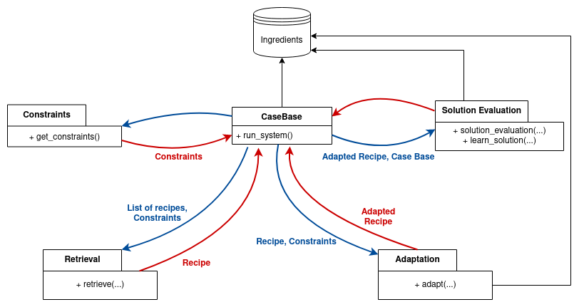

SYSTEM REQUIREMENTS and FUNCTIONAL ARCHITECTURE
User Constraints
New Ingredients
Recipe Retrieval
Recipe Adaptation
Solution Evaluation
Response Time
Memory

Slide 4

SOLUTION DESIGN

Slide 5

CASE BASE
Entry point of the system
Flat Case Base
Easy to implement and adapt for any query
Always finds the optimal recipe
Small initial recipe database
Capacity of 100 recipes
Check in add_case()
Recipe
Title
List of ingredients and its categories
Preparation steps
Utility measures

Slide 6
RETRIEVAL
Objective: Find the easiest case to be adapted.
Before this step, we ask the user to introduce the constraints: Ingredient must be and ingredients must not be in the recipe.
Each ingredient will have a category about what can be done with it.
Two steps:
Select the possible recipes: These will be the ones that have ingredients of the same categories of the ones in the constraints.
Compute similarity of the selected recipes and select the most similar. Similarity is calculated as the amount of constraints satisfied, giving more weight to the most not constraints.

Slide 7
RETRIEVAL
Constraints: Baguette (bread), bacon (meat), not cheese (cheese)
Recipe 1
Pain de mie
Ham
Cheese
Butter
Recipe 2
Baguette
Loin
Tomato
Olive oil
Recipe 3
Brioche bread
Tomato
Avocado
Mango
Arugula
Possible recipes:
Recipe 2
Baguette ✔
Bacon X
not Cheese ✔
Similarity 11/12 = 0.92
Recipe 4
Baguette X
Bacon X
not Cheese ✔
Similarity 10/12 = 0.83
Recipe 4
Pain de mie
Apple
Chicken
Recipe 5
Pita bread
Pesto
Cashew nuts
Carotte

Slide 8
ADAPTATION
Based on Abstraction/Respecialization mechanism.
Find substitutions between ingredients of the same category:
Substitute ingredients to delete with ingredients to add.
If some ingredient to add is remaining:
Substitute not necessary ingredients with ingredients to add.
If some ingredient to delete is remaining:
Substitute ingredients to delete with random selected ingredients.

Slide 9
ADAPTATION
To do the substitutions:
List of ingredients is updated.
Not necessary to update the categories.
We search for words:
In original form.
Lowercase.
If the name is compound we search for each individual word.
If possible, without 1 or 2 last characters (for all the previous searched words).

Slide 10
ADAPTATION TESTING
Spread a slice of bread with cream cheese. | Spread a slice of pita bread with avocado.
Peel the cucumber and cut into thin slices. | Peel the mango and cut into thin slices.
In a bowl, mix the same quantities of cream and of ketchup. | In a bowl, mix the same quantities of avocado and of ketchup.
Mince some Chinese cabbage into thin strips. | Mince some Chinese lettuce into thin strips.
Sometimes, some incoherences are present.
Impossible to take into account all the possible cases.

Slide 11
Solution EVALUATION
Correctness rating = Criterion1*0.3 + Criterion2*0.3 + Criterion3*0.3 + Criterion4*0.05 + Criterion5*0.05
Criterion 1: Evaluate whether constraints are satisfied
Criterion 2: Evaluate whether all ingredients are mentioned in the steps of the recipe
Criterion 3: Evaluate whether ingredients are mentioned in the steps of the recipe and are not part of the recipe
Criterion 4: Evaluate whether ingredients are associate with the wrong action
Criterion 5: Evaluate the coherence of the steps

Slide 12
Solution EVALUATION TESTING
TEST 1: cream cheese, not smoked salmon
ADAPTED RECIPE:
Pain de mie, Chicken breast, Tomato, Lettuce, Mayonnaise, Cream cheese
Cut the tomato into slices, chop salad.
Remove the pit and skin of the cream cheese, cut it in slices.
Lightly toast four thick slices of bread on both sides.
Coat the first tranche of mayonnaise and add successively cut salad,
sliced tomatoes, another slice of bread spread with mayonnaise, lettuce, chicken breast,
a slice of bread, cream cheese slices, salad and a final slice of bread.
Flatten the sandwich then cut diagonally into triangles.
EVALUATION RESULTS: (0/2)*0.3 + (0/6)*0.3 + (0/10)*0.3 + (1/10)*0.05 + (0/7)*0.05 = 0.005
TEST 2: mango, butter, light cream, hummus, not avocado
ADAPTED RECIPE:
Pita bread, Chicken, Cabbage, Tomato, Light cream, Ketchup, Chili powder
In a bowl, mix the same quantities of cream and of ketchup.
Add a pinch of chili powder.
Peel and seed the tomatoes before cutting into small cubes.
Mince some Chinese cabbage into thin strips.
Crumble the smoked chicken.
Open the pita bread and spread with the sauce.
Top with cabbage, tomatoes and smoked chicken.
EVALUATION RESULTS: (3/5)*0.3 + (0/7)*0.3 + (0/7)*0.3 + (0/7)*0.05 + (0/7)*0.05 = 0.18

Slide 13

LEARNING
When we learn?
When the evaluation of solution give us a value less than 0.35. If value is lower than 0.35 we consider that the adapted solution is a good solution.
When we do forget?
We forget cases when the evaluation solution has a bigger value than 0.35 and the utility measure is lower than a threshold value that we fixed at 0.4

Slide 14
CONCLUSIONS
If there is a solution that is possible to adapt, the retrieval returns it.
The adaptation takes into account variations of a word, but it is not possible to consider all possible cases.
The definition of the criteria used for solution evaluation seems to be robust enough to detect potential mistakes in the solutions.
Retrieval + Adaptation ➜ 0.006s (with 21 recipes)
Required memory: 48 bytes/recipe (max 100)

